Slide 1
18ECO133T Sensors and Transducers 3 Credit Course UNIT IV

Slide 2
Magnetic sensors: Introduction Villari effect , Wiedmann effect Hall effect, Construction, performance characteristics, and its Application Introduction to smart sensors Film sensors: Introduction Thick film sensors Microelectromechanical systems Micromachining. Nano sensors Applications: Industrial weighing systems: Link–lever mechanism Load cells – pneumatic, elastic and their mounting. different designs of weighing systems. conveyors type. weighfeeder type.

Slide 3
Magnetic Sensors
It serves a strong impact in changing properties of certain materials.
It produces effects which are mechanical or electrical in nature.
A magnetic sensor is a sensor that detects the magnitude of magnetism and geomagnetism generated by a magnet or current. There are many different types of magnetic sensors.

Slide 4
Magnetic Sensors-Types
Magnetic field sensor
Magneto elastic sensors
Magnetic elastic sensor
Torque/force sensors
Magneto resistive sensors
Hall effect sensors or magnetogalvanic sensors
Distance or proximity sensors
Wiegand and pulse wire sensors
Superconducting Quantum Interference Devices (SQUIDs)
Magnetostriction

Slide 5
Magnetic field sensor
The Magnetic Field Sensor can be used to study the field around permanent magnets, coils, and electrical devices. It features a rotating sensor tip to measure both transverse and longitudinal magnetic fields.
Developed following ‘Δy effect’ which is observed as change in Young’s modulus with magnetization. The sensors are often termed as Acoustic Delay Line Components (ADLC).
Note: Young’s modulus - the modulus of elasticity in tension or compression (i.e., negative tension), is a mechanical property that measures the tensile or compressive stiffness of a solid material when the force is applied lengthwise. It quantifies the relationship between tensile/compressivestress

Slide 6
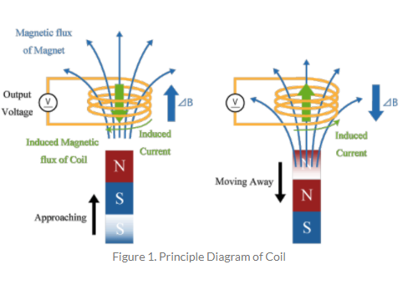
Example of Magnetic field sensor (coils)
Coils are the simplest magnetic sensors that can detect changes of the magnetic flux density

Slide 7
Example of Magnetic field sensor (coils)
when a magnet is brought close to the coil, the magnetic flux density in the coil increases by ΔB.
Then, an induced current that generates a magnetic flux in a direction that hinders an increase in magnetic flux density is generated in the coil.
Conversely, moving the magnet away from the coil reduces the magnetic flux density in the coil, so induced electromotive force and induced current will be generated in the coil to increase the magnetic flux density.

Slide 8
Magneto - elastic sensor
Based on the fact that in a longitudinal field, torsion given in a ferromagnetic rod changes in magnetization – Matteucci effect –(Voltage generating property of a twisted ferro-magnetic wire upon change of magnetization).
Magnetoelastic sensors are amorphous ferromagnetic ribbons that exhibit a magneto-mechanical resonance when excited by a time varying magnetic field. Magnetoelastic sensors have successfully been used for stress, pressure, liquid viscosity and density, fluid flow velocity, elasticity, and temperature monitoring.

Slide 9
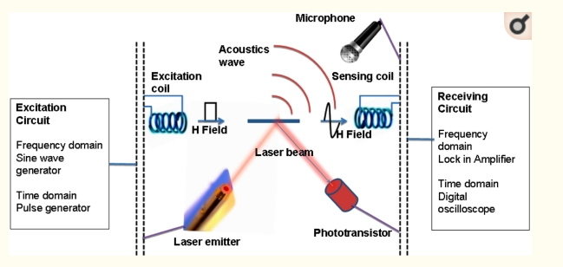
Magneto - elastic sensor

Slide 10
Magnetic elastic sensor
Produced using villari effect in which a tensile or compressive stress changes magnetization or affects magnetization in some way.
The inverse magnetostrictive effect, magnetoelastic effect or Villari effect is the change of the magnetization of a material when subjected to a mechanical stress.

Slide 11
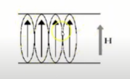
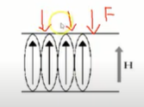
Villari effect
If External magnetic field is applied to ferromagnetic material in vertical direction, the dipoles gets arranged in the same direction
Apply force to Ferromagnetic material

Slide 12
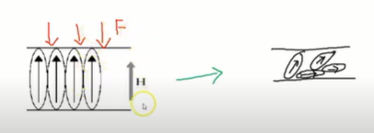
Villari effect
This changes the direction of dipoles. Even though the external magnetic field tries to align the dipoles, the force changes the structure and direction of dipole (random fashion).

Slide 13
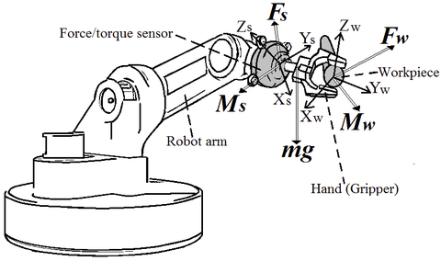
Torque/force sensors
A force torque (FT) sensor is an electronic device that is designed to monitor, detect, record and regulate linear and rotational forces exerted upon it.

Slide 14
Torque/force sensors
Wiedemann effect is used to develop the torque/force sensors. In such sensors, The twisting of a ferromagnetic rod through which an electric current is flowing when the rod is placed in a longitudinal magnetic field

Slide 15
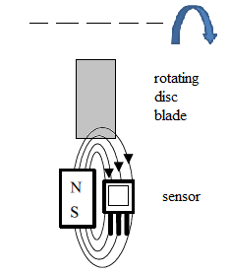
Magnetoresistive sensors
Becoming increasingly popular, are developed on the basis of ‘Thomson effect’ which is basically a change in resistance of specified materials with magnetic field impressed.
A magnetoresistive sensor uses the fact that the electrical resistance in a ferromagnetic thin film alloy is changed through an external magnetic field

Slide 16
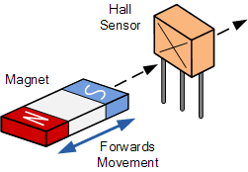
Hall effect sensors (or) magnetogalvanic sensors
Most common and widely used type magnetic sensors.
These operate on the fact that a crystal carrying a current when subjected to a magnetic field perpendicular to the direction of the current, produces a transverse voltage.

Slide 17
Hall effect sensors
A Hall effect sensor (or simply Hall sensor) is a type of sensor which detects the presence and magnitude of a magnetic field using the Hall effect. The output voltage of a Hall sensor is directly proportional to the strength of the field
In a Hall sensor, a current is applied to thin strip of metal. In the presence of a magnetic field perpendicular to the direction of the current, the charge carriers are deflected by the Lorentz force, producing a difference in electric potential (voltage) between the two sides of the strip. This voltage difference (the Hall voltage) is proportional to the strength of the magnetic field.
Hall sensors are used for proximity sensing, positioning, speed detection, and current sensing applications.

Slide 18
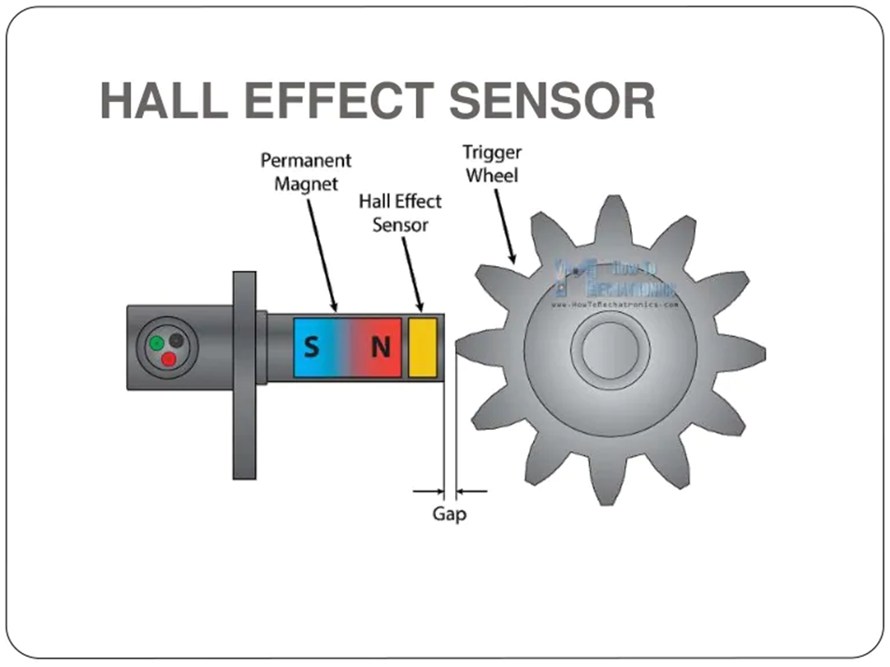
Application of Hall sensor
Voltage produced rotates the gear wheel (in anti lock braking system)

Slide 19
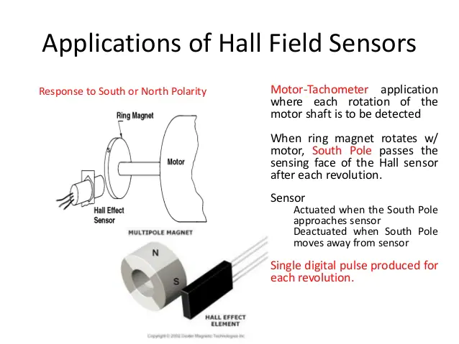

Slide 20
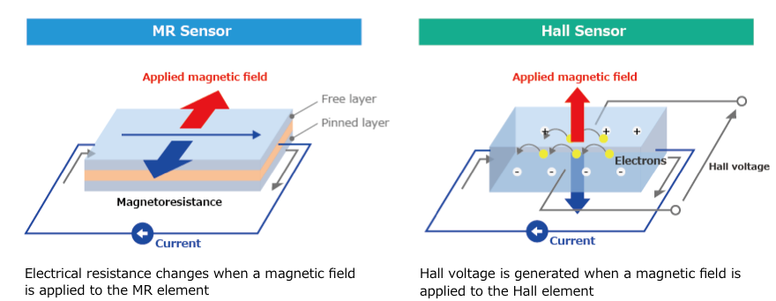
Hall sensor Vs Magnetic sensor
A Hall sensor detects the strength of a magnetic field perpendicular to it, whereas an MR sensor detects the angle of a parallel magnetic field

Slide 21
Distance (or) proximity sensors
Packed in a small package with low power consumption, this IR proximity sensor allows for continuous distance reading with a range of 10cm to 80cm
Developed based on ‘skin effect’ in which eddy current forces the current flowing through the interior of a material to move to its surface level.
Proximity (nearness in space) of the object is detected by a change in capacitance. The sensor can also be used to detect a wide variety of non-metallic and metallic objects and typically operate over a range of 3 to 30 mm.

Slide 22
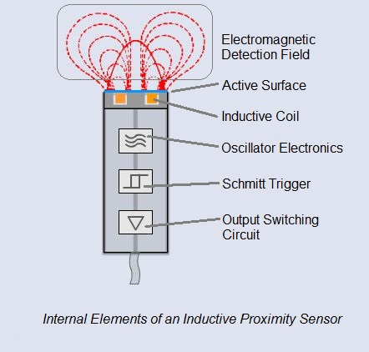
Distance (or) proximity sensors

Slide 23
Wiegand and pulse wire sensors
Tiny devices that use variations in an external magnetic field to generate electrical signals and energy
A specific type of material when subjected to pulse voltages under stress shows switching effect which occurs due to Barkhausen jump.
This is utilized to produce such sensors. The effect is called ‘Sixtus-Tonks effect’ after the experimenter who demonstrated it.

Slide 24
Wiegand and pulse wire sensors
Wiegand sensors are built around small sections of Wiegand wire, a specially prepared ferromagnetic alloy that has a unique physical property.
When exposed to an alternating external magnetic field, a Wiegand wire will initially retaining its magnetic polarity - when the external field reaches a certain threshold, the polarity of the wire segment will abruptly reverse.
This polarity switch occurs within a few microseconds and can generate a distinct current pulse in a fine copper coil wrapped around the ferromagnetic core.
This pulse is strong enough to activate logic circuits and can be used to energize low power electronic chips. This self-powering capacity of Wiegand sensors helps make them more reliable – and safer – since they can provide signals for alarm systems without external power sources. There is no need to check or replace backup batteries, sharply reducing maintenance requirements

Slide 25
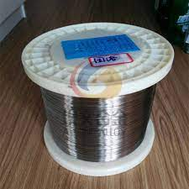
Wiegand and pulse wire sensors
The Wiegand effect is a nonlinear magnetic effect, named after its discoverer John R. Wiegand, produced in specially annealed and hardened wire called Wiegand wire
Wiegand wire is low-carbon Vicalloy, a ferromagnetic alloy of cobalt, iron, and vanadium. Initially, the wire is fully annealed. In this state the alloy is "soft" in the magnetic sense; that is, it is attracted to magnets and so magnetic field lines will divert preferentially into the metal, but the metal retains only a very small residual field when the external field is removed

Slide 26
Superconducting Quantum Interference Devices (SQUIDs)
A SQUID (Superconducting Quantum Interference Device) is a very sensitive magnetometer used to measure extremely subtle magnetic fields, based on superconducting loops containing Josephson junctions.
SQUIDs are sensitive enough to measure fields as low as 5×10⁻¹⁴ T
Based on the superconducting state specifically, ‘flux quantization and Josephson effect’, SQUODs are used in various applications
These types of sensors have a resolution of the order of a few femtoTesla(fT).

Slide 27
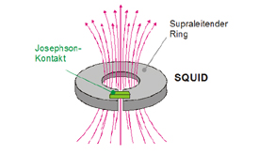
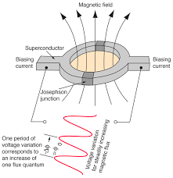
SQUID

Slide 28
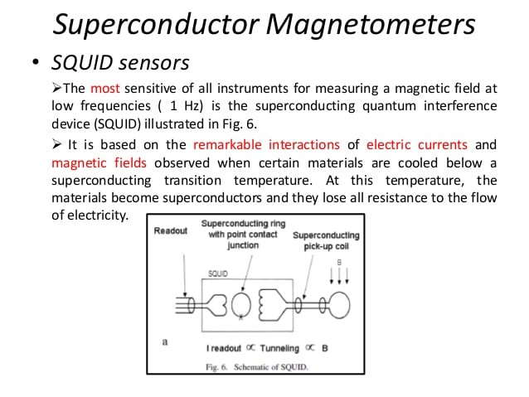

Slide 29
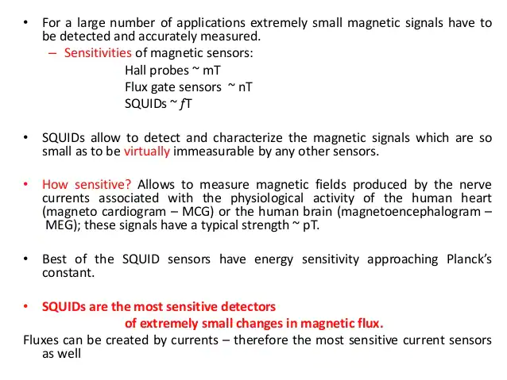

Slide 30
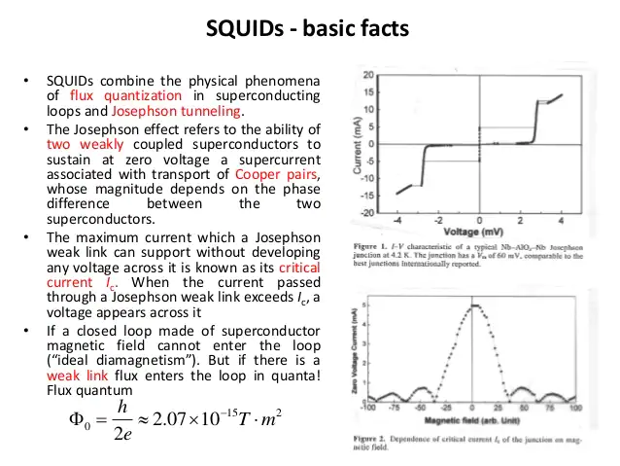

Slide 31
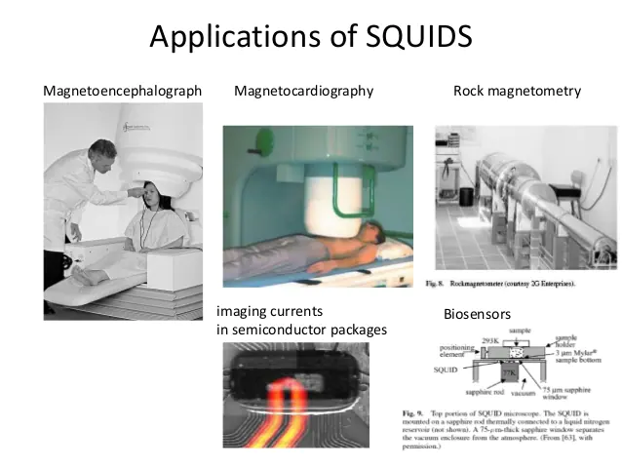

Slide 32
Magnetostriction
Magnetostriction is a property of ferromagnetic materials that causes them to change their shape when subjected to a magnetic field.
Phenomenon known over a century and half, has been used in combination with piezoelectric elements for field measurements.
This effect is known as ‘Joule effect’ in which magnetization changes the shape of ferromagnetic material body.

Slide 33
Magnetostriction
Magnetostrictive materials are used to convert electromagnetic energy into mechanical energy and vice versa. This effect can be used to create sensors that measure a magnetic field or detect a force. The magnetic field or force applied would create a strain in the material, which can be measured.
Its magnetic field magnetises the wire axially. Since the two magnetic fields are superimposed, around the float magnet a torsion wave is generated which runs in both directions along the wire.

Slide 34
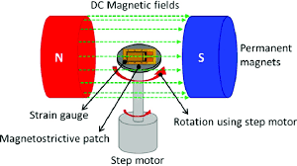
Magnetostriction

Slide 35
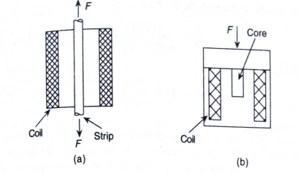
VILLARI Effect
Based on Villari effect, three basic types of magnetoelastic sensors may be designed.
A. The mechanical loading is unidirectional so as to produce compression or tension and this changes the inductance or permeability with the specimen having predefined magnetic flux path, as in choke or coil type design.

Slide 36
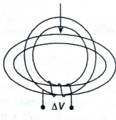
VILLARI Effect
B. Mechanical loading changes the flux in 2 directions or in a plane as in circular rings or laminated cores.
Circular ring is deformed into elliptical form and change in inductance of the ring or change in voltage in the secondary winding ΔV gives the value of the load.
In case of laminated core load cells, isotropic magnetic materials are used which become anisotropic under stress due to varying deformation in longitudinal and transverse directions relative to load axis and change in voltage can be derived in ring type design.

Slide 37
Villari effect
C. Loading changes the flux spatially, that is 3 dimensionally in torque transducers for shafts.
If the shaft material does not have the requisite magnetic properties such as magnetostriction, an additional magnetic coating on the shaft surface produces the desired mechanical stress on this surface that is to be measured.

Slide 38
Smart Sensors-Introduction
The Sensors are devices that responds to a physical stimulus heat, light, sound, pressure, magnetism, motion, etc , and convert that into an electrical signal.
They perform an input function
The Devices which perform an output function are generally called Actuators and are used to control some external device, for example movement.
Both sensors and actuators are collectively known as Transducers. Transducers are devices used to convert energy of one kind into energy of another kind.

Slide 39
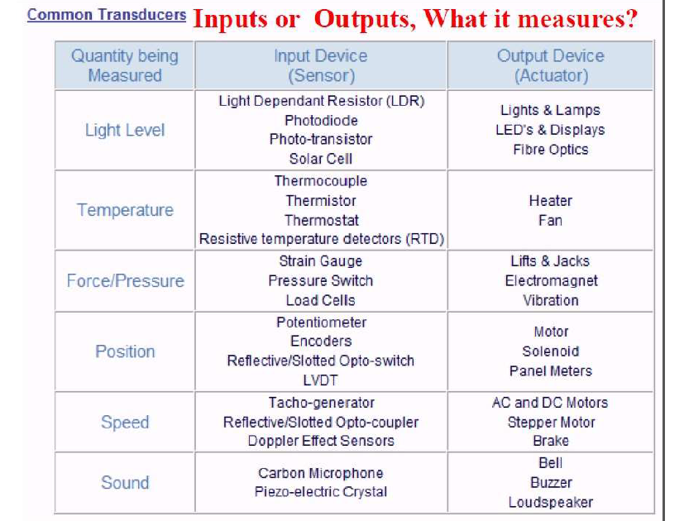

Slide 40
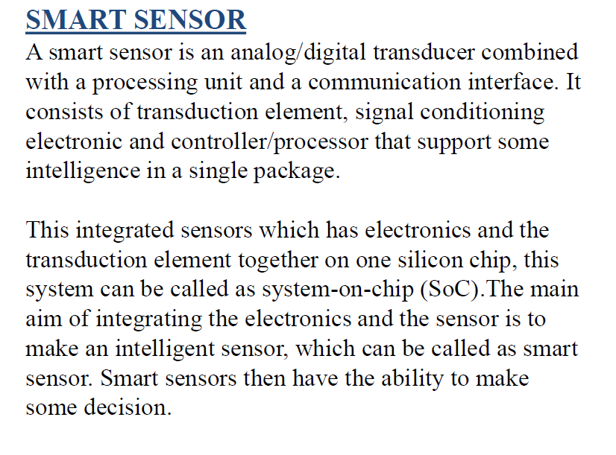

Slide 41
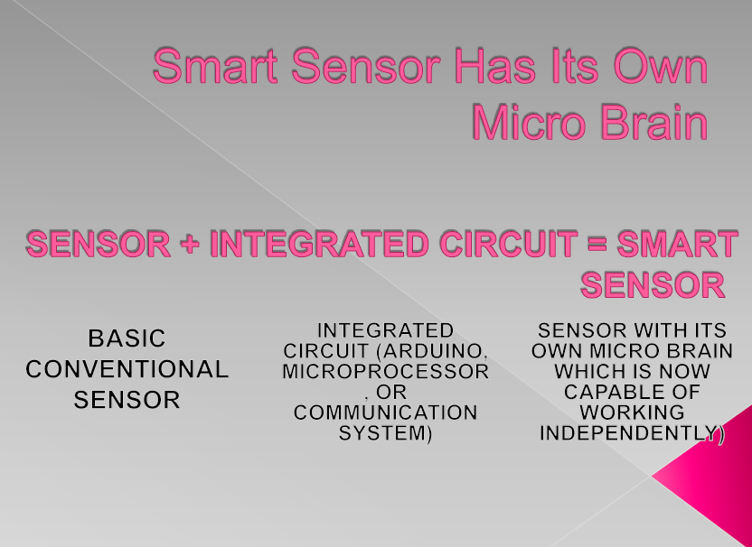

Slide 42
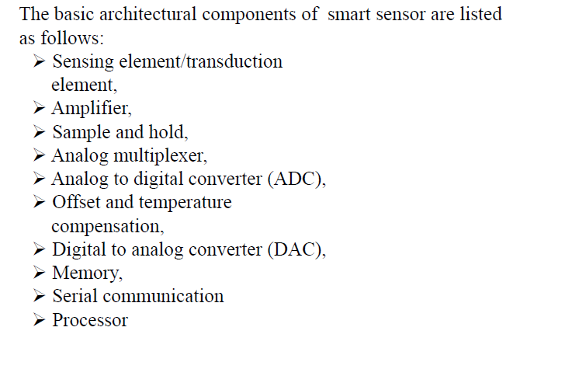
General Architecture of Smart Sensor

Slide 43
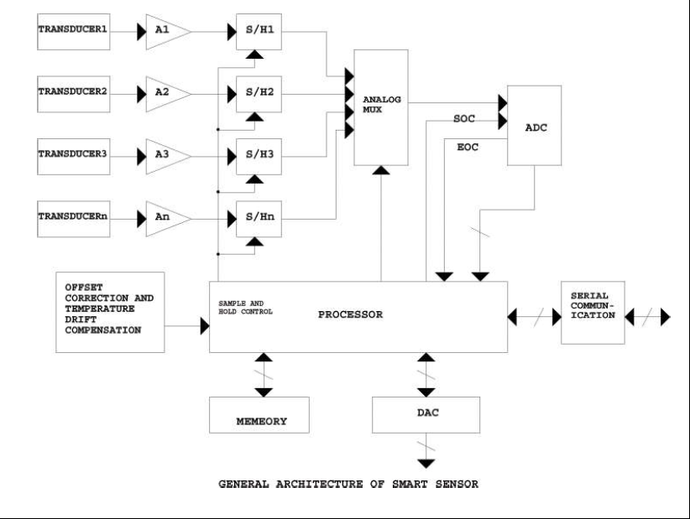

Slide 44
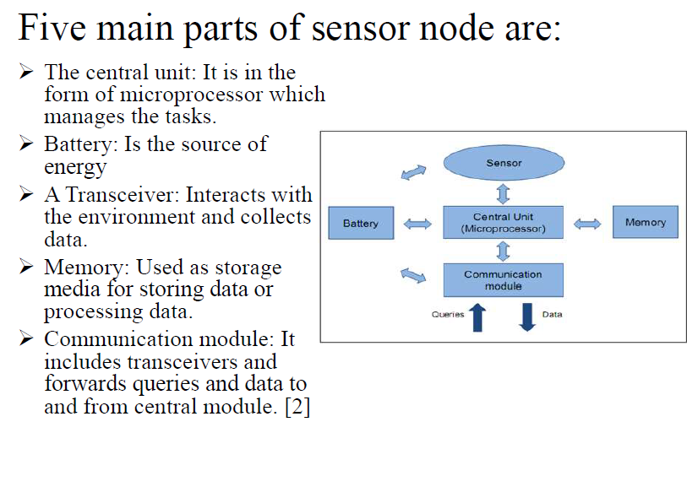

Slide 45
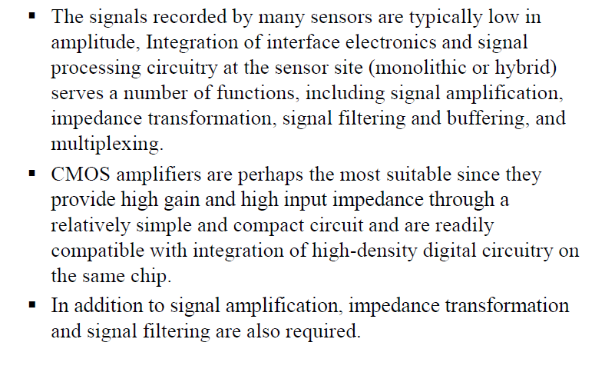
Information Coding/Processing

Slide 46
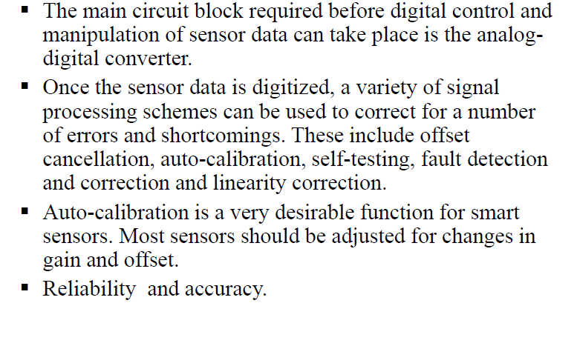
Data Compensation

Slide 47
Top Smart Sensors -
Temperature Sensors
Proximity Sensor
Pressure Sensor
Gas & Smoke Sensor
Accelerometer Sensors
Level Sensors
Image Sensors
Motion Detection Sensors
Optical Sensors
Gyroscope Sensors

Slide 48
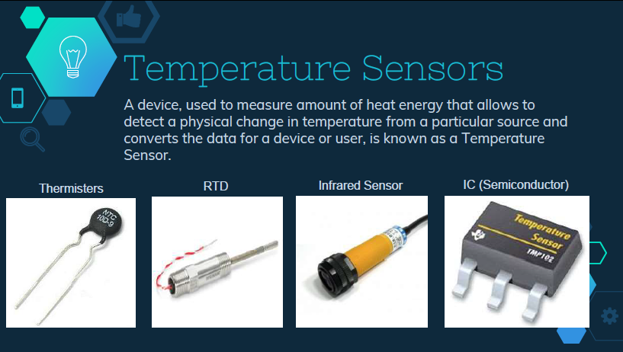
Smart Sensors (Cont..)

Slide 49

Smart Sensors (Cont..)

Slide 50

Smart Sensors (Cont..)

Slide 51

Smart Sensors (Cont..)

Slide 52
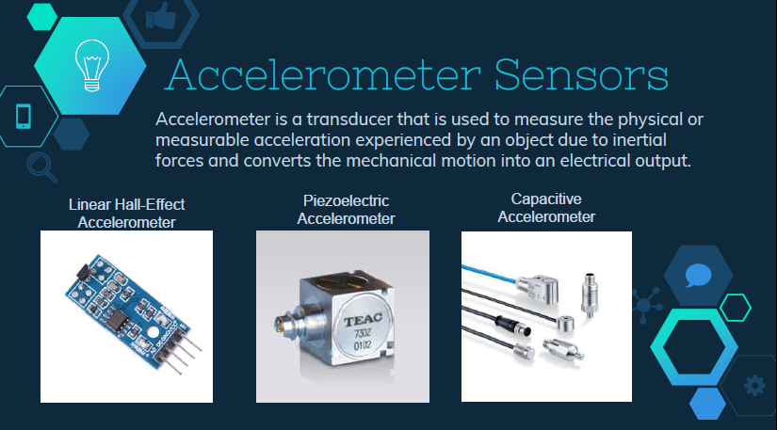
Smart Sensors (Cont..)

Slide 53
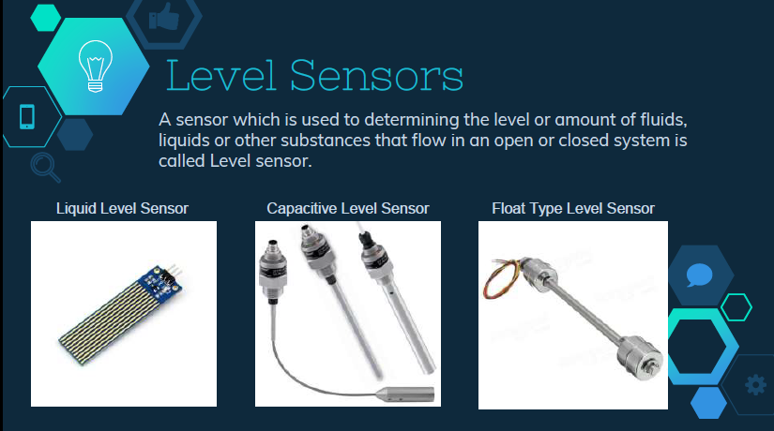
Smart Sensors (Cont..)

Slide 54
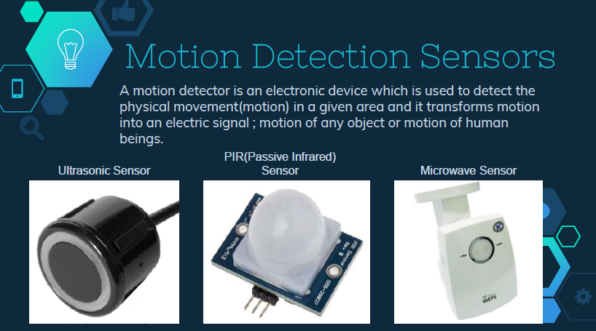
Smart Sensors (Cont..)

Slide 55
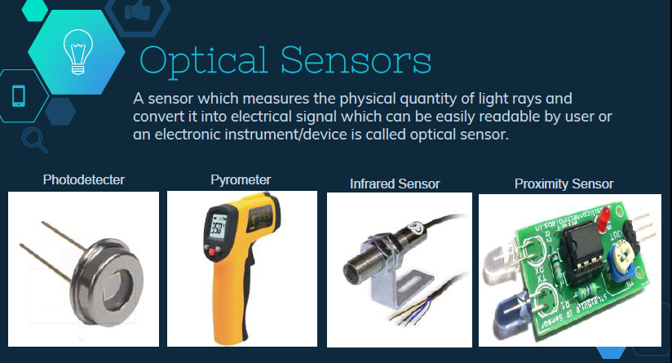
Smart Sensors (Cont..)

Slide 56
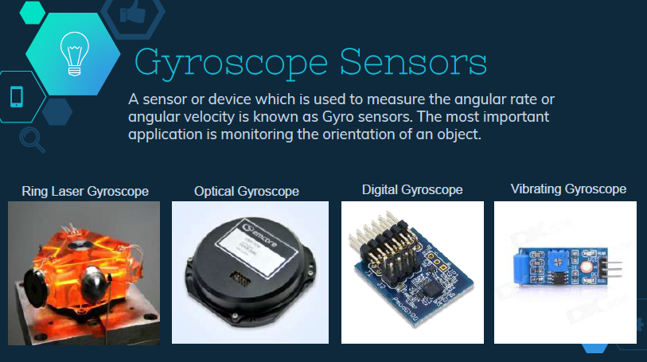
Smart Sensors (Cont..)

Slide 57

Smart Sensors (Cont..)

Slide 58
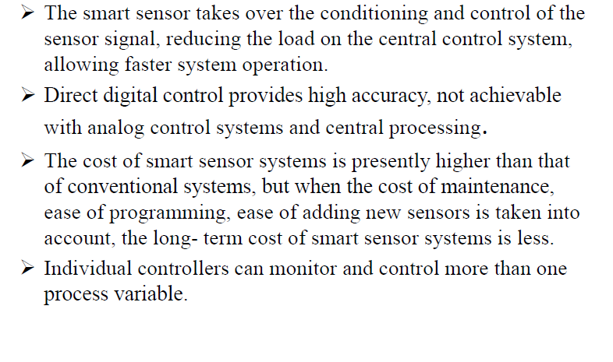
Advantage -

Slide 59
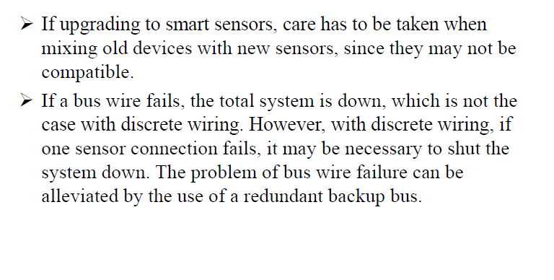
Disadvantages -

Slide 60
MEMS
A MEMS (micro-electromechanical system) is a miniature machine that has both mechanical and electronic components. The physical dimension of a MEMS can range from several millimeters to less than one micrometer, a dimension many times smaller than the width of a human hair
The label MEMS is used to describe both a category of micromechatronic devices and the processes used when manufacturing them.
https://internetofthingsagenda.techtarget.com/definition/micro-electromechanical-systems-MEMS

Slide 61
MEMS
Some MEMS do not even have mechanical parts, yet they are classified as MEMS because they miniaturize structures used in conventional machinery, such as springs, channels, cavities, holes and membranes.
Because some MEMS devices convert a measured mechanical signal into an electrical or optical signal, they may also be referred to as transducers.
In Japan, MEMS are more commonly known as micromachines, and in European countries, MEMS are more commonly referred to as microsystems technology (MST).

Slide 62
MEMS
MEMS are composed of parts such as microsensors, microprocessors, microactuators, units for data processing and parts that can interact with exterior pieces.
Unlike conventional mechatronic devices, MEMS are often manufactured with the same batch fabrication techniques used to create integrated circuits (ICs) and many commercial MEMS products are integrated and packaged together with ICs. MEMS fabrication allows micro-sensors, which gather data, and micro-actuators, which convert energy into motion, to integrate on the same substrate.
Although MEMS have a low per-device production cost, packaging can be a challenge. Each MEMS must be packaged so that electrical or optical circuitry and other device components remain free from air and water contamination, while still being able to interact with the surrounding environment and accommodate motion.

Slide 63
MEMS
Example:
The small system on a chip (SOC) that automatically adjusts screen orientation on a smartphone is an example of a MEMS many people interact with each day. As MEMS become smaller, require less power and are less expensive to manufacture, they are expected to play an important part in the wireless internet of things (IoT) and home automation
Applications:
Sensor-driven heating and cooling systems for building management systems.
Micro-mirror arrays for high definition projection systems.
Smart dust for the detection of environmental changes in molecular manufacturing (nanotechnology) clean rooms.
Micronozzles to control the flow of ink in inkjet printers.
Tiny gyroscopes, barometers, accelerometers and microphones to support Mobile apps.
Disposable pressure sensors for use in healthcare.
Optical switching devices that allow one optical signal to control another optical signal.

Slide 64
WHAT IS MEMS
MEMS = MicroElectroMechanical System
Any engineering system that performs electrical and mechanical functions with components in micrometers is a MEMS. (1 µm = 1/10 of human hair)
Available MEMS products include:
Micro sensors (acoustic wave, biomedical, chemical, inertia, optical, pressure, radiation, thermal, etc.)
Micro actuators (valves, pumps and microfluidics;electrical and optical relays and switches; grippers, tweezers and tongs;linear and rotary motors, etc.)
Read/write heads in computer storage systems.
Inkjet printer heads.
Micro device components (e.g., palm-top reconnaissance aircrafts, mini robots and toys, micro surgical and mobile telecom equipment, etc.)

Slide 65
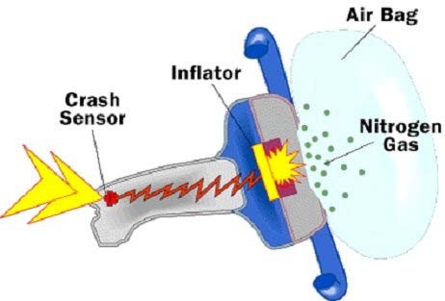


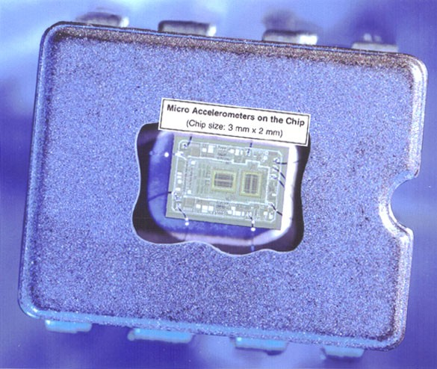
Inertia Sensor for Automobile “Air Bag” Deployment System
Micro inertia sensor (accelerometer) in place:
Sensor-on-a-chip: (the size of a
rice grain)
(Courtesy of Analog Devices, Inc)

Slide 66
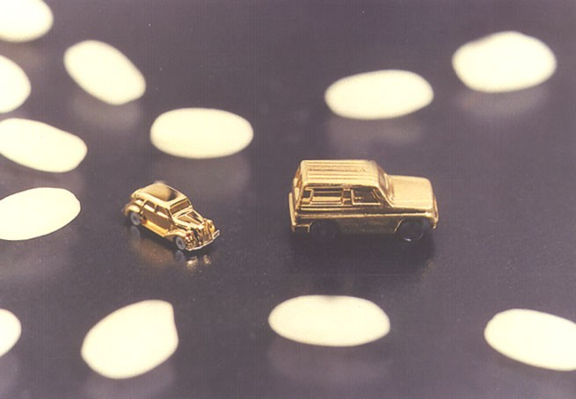
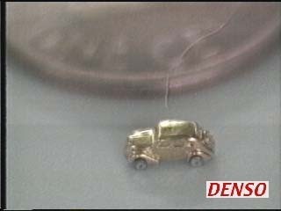
Micro Cars (Courtesy of Denso Research Laboratories, Denso Corporation, Aichi, Japan)
Rice grains

Slide 67
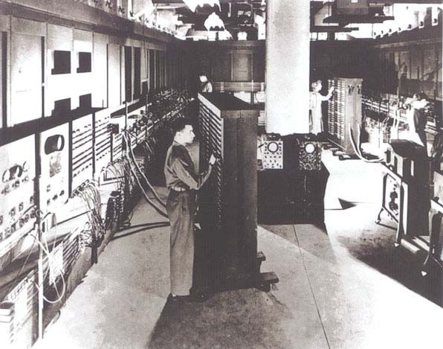
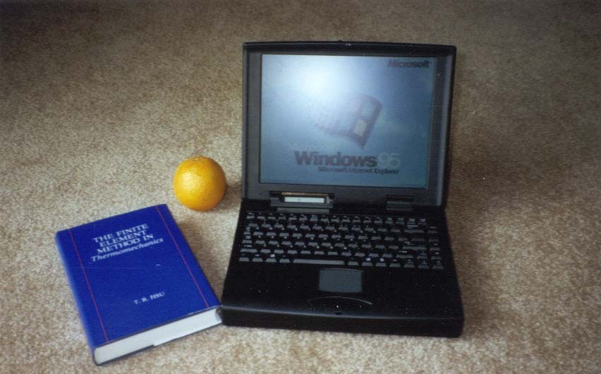
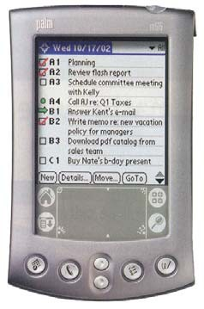
Miniaturization of Digital Computers - A remarkable case of miniaturization!
Size: 10⁶ down
Power: 10⁶ up
The ENIAC Computer in 1946
A “Lap-top” Computer in 1996
Size: 10⁸ down
Power: 10⁸ up
A “Palm-top” Computer in 2001
This spectacular miniaturization took place in 50 years!!

Slide 68
MINIATURIAZATION – The Principal Driving Force for the 21st Century Industrial Technology
There has been increasing strong market demand for:
“Intelligent,”
“Robust,”
“Multi-functional,” and
“Low-cost”
industrial products.
Miniaturization is the only viable solution to satisfy such market demand

Slide 69
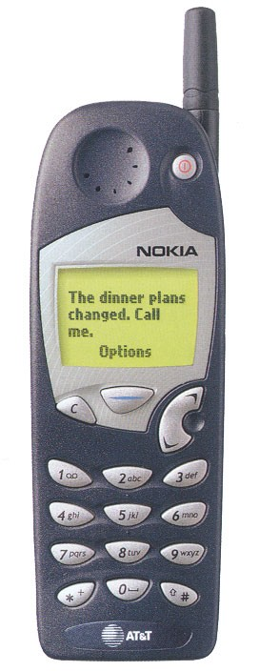

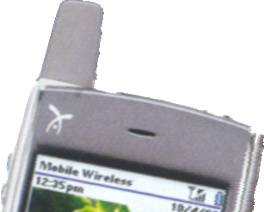

Market Demand for Intelligent, Robusting, Smaller, Multi-Functional Products - the evolution of cellular phones
Mobil phones 10 Years Ago:
Current State-of-the Art:
Size reduction
Palm-top Wireless PC
Transceive voice+ multi-media + others (Video-camera, e-mails, calendar, and access to Internet, GPS and a PC with key pad input)
Transceive voice only
The only solution is to pack many miniature function components into the device

Slide 70
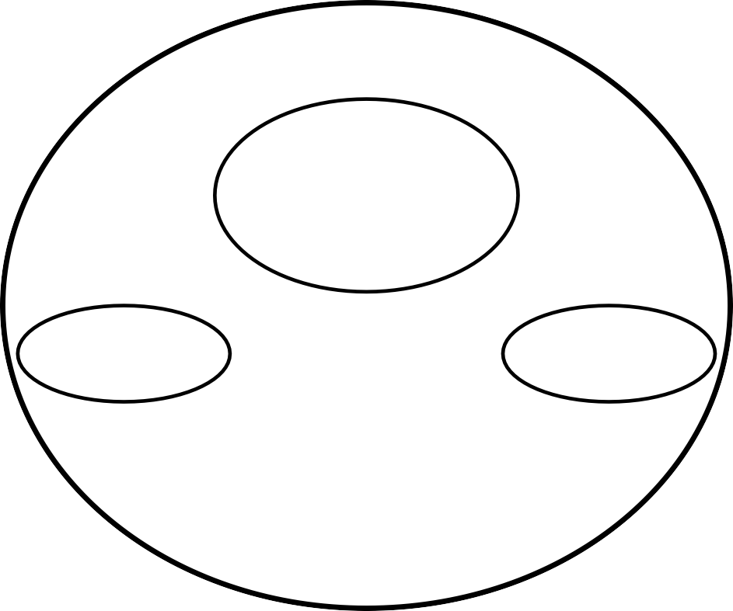
Components of Microsystems
Power Supply
Signal Transduction & Processing
Unit
Sensor
Actuator
Microsystem

Slide 71
Comparison of Microelectronics and Microsystems
Microelectronics | Microsystems (silicon based)
Primarily 2-dimensional structures | Complex 3-dimensional structure
Stationary structures | May involve moving components
Transmit electricity for specific electrical functions | Perform a great variety of specific biological, chemical, electromechanical and optical functions
IC die is protected from contacting media | Delicate components are interfaced with working media
Use single crystal silicon dies, silicon compounds, ceramics and plastic materials | Use single crystal silicon dies and few other materials, e.g. GaAs, quartz, polymers, ceramics and metals
Fewer components to be assembled | Many more components to be assembled
Mature IC design methodologies | Lack of engineering design methodology and standards
Complex patterns with high density of electrical circuitry over substrates | Simpler patterns over substrates with simpler electrical circuitry
Large number of electrical feed-through and leads | Fewer electrical feed-through and leads
Industrial standards available | No industrial standard to follow in design, material selections, fabrication processes and packaging
Mass production | Batch production, or on customer-need basis
Fabrication techniques are proven and well documented | Many microfabrication techniques are used for production, but with no standard procedures
Manufacturing techniques are proven and well documented | Distinct manufacturing techniques
Packaging technology is relatively well established | Packaging technology is at the infant stage
Primarily involves electrical and chemical engineering | Involves all disciplines of science and engineering

Slide 72
Scaling Laws in Miniaturization
In this era of “think small,” one would intuitively simply scale down the size of all components to a device to make it small. Unfortunately, the reality does not work out that way.
It is true that nothing is there to stop one from down sizing the device components to make the device small. There are, however, serious physical consequences of scaling down many physical quantities.
TYPES OF SCALING
Scaling in Geometry
Scaling in Rigid-Body Dynamics
Scaling in Electrostatic Forces
Scaling in Electromagnetic Forces
Scaling in Electricity
Scaling in Fluid Mechanics
Scaling in Heat Transfer

Slide 73
WHY SCALING LAWS?
Miniaturizing machines and physical systems is an ongoing effort in human civilization.
This effort has been intensified in recent years as market demands for:
Intelligent, Robust, Multi-functional and Low cost
consumer products has become more strong than ever.
The only solution to produce these consumer products is to package many components into the product –
making it necessary to miniaturize each individual components.
Miniaturization of physical systems is a lot more than just scaling down device components in sizes.
Some physical systems either cannot be scaled down favorably, or cannot be scaled down at all!

Slide 74

Types of Scaling Laws
Scaling laws become the very first thing that any engineer would do in the design of MEMS and microsystems.
1. Scaling in Geometry:
Scaling of physical size of objects
2. Scaling of Phenomenological Behavior
Scaling of both size and material characterizations

Slide 75
Scaling in Geometry
Volume (V) and surface (S) are two physical parameters that are frequently involved in machine design.
Volume leads to the mass and weight of device components.
Volume relates to both mechanical and thermal inertia. Thermal inertia is a measure on how fast we can heat or cool a solid. It is an important parameter in the design of a thermally actuated device.
Surface is related to pressure and the buoyant forces in fluid mechanics. For instance, surface pumping by using piezoelectric means is a practical way for driving fluids flow in capillary conduits.
When the physical quantity is to be miniaturized, the design engineer must weigh the magnitudes of the possible consequences from the reduction on both the volume and surface of the particular device.

Slide 76
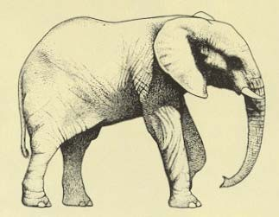
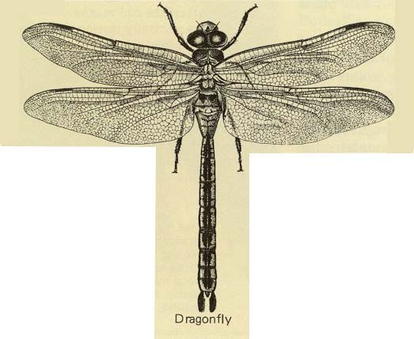
Scaling in Geometry
If we let ℓ = linear dimension of a solid, we will have:
S/V = ℓ⁻¹
A 10 times reduction in length
→ 10³ = 1000 time reduction in volume. But
→ 10² = 100 time reduction in surface area.
The volume:
V ∝ l³
S ∝ l²
The surface:
Since volume, V relates to mass and surface area, S relates to buoyancy force:
S/V ≈ 10⁻⁴/mm
S/V ≈ 10⁻¹/mm
So, an elephant can never fly as easily as a dragonfly!!

Slide 77

Scaling Laws in Miniaturization
Scaling theory is a value guide to what may work and what may not work when we start to design the world of micro.

Slide 78

Range of sizes of objects studied by biochemists and biologists. (Biochemistry by Mathews et al.)

Slide 79
SUBSTRATES AND WAFERS
The frequently used term substrate in microelectronics means a flat macroscopic object on which microfabrication processes take place.
There are two types of substrate materials used in microsystems: (1) active substrate materials and (2) passive substrate materials
Active substrate materials are primarily used for sensors and actuators in a microsystem or other MEMS components(Si,Ge,GaAs,Quartz)

Slide 80
Silicon – an ideal substrate material for MEMS
Silicon (Si) is the most abundant material on earth. It almost always exists in compounds with other elements.
Single crystal silicon is the most widely used substrate material for MEMS and microsystems.
The popularity of silicon for such application is primarily for the following reasons:
It is mechanically stable and it is feasible to be integrated into electronics on the same substrate.Electronics for signal transduction such as the p or n-type piezoresistive can be readily integrated with the Si substrate-ideal for transistors.
Silicon is almost an ideal structure material. It has about the same Young’s modulus as steel ( 2x10⁵ MPa), but is as light as aluminum with a density of about 2.3 g/cm³.

Slide 81
It has a melting point at 1400ºC, which is about twice higher than that of aluminum. This high melting point makes silicon dimensionally stable even at elevated temperature.
Its thermal expansion coefficient is about 8 times smaller than that of steel, and is more than 10 times smaller than that of aluminum.
Silicon shows virtually no mechanical hysteresis. It is thus an ideal candidate material for sensors and actuators. Silicon wafers are extremely flat for coatings and additional thin film layers for either being integral structural parts, or performing precise electromechanical functions.
There is a greater flexibility in design and manufacture with silicon than with other substrate materials. Treatments and fabrication processes for silicon substrates are well established and documented.

Slide 82

Pure silicon wafers
Pure silicon boules of 300 mm diameter and 30 ft long, can weigh up to 400 Kg.
A pure silicon boule
These boules are sliced into thin disks (wafers) using diamond saws.
300 mm wafer
200 mm wafer
Standard sizes of wafers are:
100 mm (4”) diameter x 500 μm thick.
150 mm (6”) diameter x 750 μm thick.
200 mm (8”) diameter x 1 mm thick
300 mm (12”) diameter x 750 μm thick (tentative).

Slide 83
SI WAFER PRODUCTION, CZ PROCESS, (S3)

Slide 84
SI WAFER PRODUCTION STEPS
Crystal Growth and Wafer Slicing Process
Thickness Sorting
Lapping & Etching Processes
Thickness Sorting and Flatness Checking
Polishing Process
Final Dimensional and Electrical Properties Qualification

Slide 85


Crystal Growth and Wafer Slicing Process
Step 1: Obtaining the Sand
The sand used to grow the wafers has to be a very
clean and good form of silicon.
Step 2: Preparing the Molten Silicon Bath
It is heated to about 1600 degrees C – just above its
melting point(1400 degrees C) The molten sand will become the source of the silicon that will be the wafer.

Slide 86

Step 3: Making the Ingot
A silicon seed crystal is now placed into the molten sand bath. This crystal will be pulled out slowly as it is rotated. The result is a pure silicon cylinder that is called an ingot pure.
The diameter of the silicon ingot is determined by the temperature variables as well as the rate at which the ingot is withdrawn
Each of the wafers is given either a notch or a flat edge that will be used later in orienting the wafer into the exact position for later procedures
Step 4: Preparing the Wafers
After the ingot is ground into the correct
diameter for the wafers, the silicon ingot is
sliced into very thin wafers.
This is usually done with a diamond saw.

Slide 87

Thickness Sorting
Following slicing, silicon wafers are often sorted on an automated basis into batches of uniform thickness to increase productivity in the next process step, lapping .
During thickness sorting, the wafer manufacturer can also identify defect trends resulting from the slicing process

Slide 88

Lapping & Etching Processes
Lapping removes the surface silicon which has been cracked or otherwise damaged by the slicing process, and assures a flat Surface.
Wafers are then etched in a chemically active reagent to remove any crystal damage remaining from the previous process step.
Thickness Sorting and Flatness Checking
Following lapping or etching, silicon wafers are measured for flatness to identify and control defect trends resulting from the lapping and etching processes
Wafers are also often sorted on an automated basis according to thickness in order to increase productivity in the next process step, polishing.

Slide 89


Polishing Process
Polishing is a chemical/mechanical process that smoothes the uneven surface left by the lapping and etching processes and makes the wafer flat and smooth enough to support optical photolithography
A wafer polishing machine
Wafers in storage trays

Slide 90
Nano Sensor

Slide 91

Size and Compatibility

Slide 92

Size and Compatibility

Slide 93
Why Nanosensors?
Particles that are smaller than the characteristic lengths associated with the specific phenomena often display new chemistry and new physics that lead to new properties that depend on size
When the size of the structure is decreased, surface to volume ratio increases considerably and the surface phenomena predominate over the chemistry and physics in the bulk
The reduction in the size of the sensing part and/or the transducer in a sensor is important in order to better miniaturise the devices
Science of nano materials deals with new phenomena, and new sensor devices are being built that take advantage of these phenomena
Sensitivity can increase due to better conduction properties, the limits of detection can be lower, very small quantities of samples can be analysed, direct detection is possible without using labels, and some reagents can be eliminated.

Slide 94
Types of Nanosensors
NanoSensors
Optical Nanosensors
Chemical Nanosensors
Physical Nanosensors
Biological Nanosensors
Proximity Nanosensors
Ambient Light Nanosensors
Antibody/Antigen Interaction
DNA Interaction
Enzymatic Interaction
Chemical Composition
Molecular Concentration
Pressure
Force
Mass
Displacement

Slide 95

Optical Sensors- Proximity Sensors
Proximity sensors are designed for use in detecting the presence of an object or motion detection in various industrial, mobile, electronic appliances and retail automations.
Examples of proximity sensor usage include the detection of an out-of-paper condition in a printer or a mobile phone screen that dims to save battery life when placed near a face.

Slide 96


Optical Sensors- Ambient Light Sensors
Ambient light sensors provide precise light detection for a wide range of ambient brightness and are commonly used in LCD backlight control in mobile phones, LCD TV/panel, and notebook applications.
One way to convert the optical signal is by using electro-optical sensors - electronic detectors that convert light, or a change in light, into an electronic signal. Light has many components that can be sensed, such as the wavelength, the intensity, the polarization and the phase. The interaction of light with matter can be quantified by measuring absorbance, reflectance, luminescence and more.

Slide 97


Bio-Nanosensor

Slide 98
Biosensors
• Biosensor: analytical device for measurement of a specific analyte
• Biological material + physicochemical transducer(electrochemical, optical, thermometric, piezoelectric, magnetic or micromechanical)
• Nanomaterials and nanosensors increase sensitivity and detection level to pico-, femto-, atto- and even zepto- scales (10^-12-10^-21) – this facilitates helps in early disease detection.
Bio markers, molecules with a function indicating physiologic or pathologic state, interact with specific receptors fixed onto the surface of a biosensor transducer.

Slide 99

“A biosensor is an analytical device incorporating a biological or biologically derived sensing element either intimately
associated with or integrated within a physicochemical transducer. The usual aim is to produce a digital electronic signal
which is proportional to the concentration of a specific analyte or group of analytes”

Slide 100

Chemical Nanosensors
Chemical sensors usually contain two basic components connected in series: a chemical (molecular) recognition (receptor) and a physicochemical transducer. In the majority of chemical sensors, the receptor interacts with the analyte molecules. As a result, the physical properties are altered in such a way that the appending transducer can gain an electrical signal. In some cases, a single physical object acts as a receptor and as a transducer.
Illustration of chemiresistors with receptors, the binding of bio-molecule with net electrical charges changes the channel conductance.

Slide 101
Physical Nanosensors
The physical nanosensor sense the environmental physical change such as
Force
Acceleration
Flow rate
Mass
Volume
Density
pressure
Nanoindentor:The force range is up to 500 μN and 1 mN for the two main designs, with a force resolution of to 0.3 μN.
CNT force sensor

Slide 102

Applications of Nanosensors

Slide 103

Giant (GMR) Magnetoresistance Sensors

Slide 104

Structures and Phenomena

Slide 105

Sandwich

Slide 106


Spin Valves

Slide 107


Slide 108
GMR

Slide 109


Slide 110


Slide 111


Slide 112


Slide 113


Slide 114


Slide 115


Slide 116


Slide 117
Micromaching

Slide 118
Introduction
Implies parts are made to the size of 1 to 999µm
By the definition micro engg: as the field where component sizes are a few millimeters

Slide 119
What is Micromachining?
Micromachining is the basic technology for fabrication of micro-components of size in the range of 1 to 500 micrometers.
Their need arises from miniaturization of various devices in science and engineering, calling for ultra-precision manufacturing and micro-fabrication.

Slide 120
Important aspects
Unit removal
Equipment precision

Slide 121
Why Micro Machining?
Why Micro Machining? Present day High-tech Industries, Design requirements are stringent.
Extraordinary Properties of Materials (High Strength, High heat Resistant, High hardness, Corrosion resistant etc) Complex 3D Components (Turbine Blades) Miniature Features (filters for food processing and textile industries having few tens of microns as hole diameter and thousands in number) Nano level surface finish on Complex geometries (thousands of turbulated cooling holes in a turbine blade) Making and finishing of micro fluidic channels (in electrically conducting & non conducting materials, say glass, quartz, &ceramics).

Slide 122
Classification According to Machining phenomena
Removal by mechanical force
Removal by ablation
Removal by dissolution
Plastic deformation

Slide 123
Laser micro machining
Uses a power source (FS laser, Excimer laser) that emits a beam with very high quantum energy.

Slide 124

Laser Micromachining Process

Slide 125

Conceptual Solid Model of Laser Micromachining Setup

Slide 126
Advantages of Laser Micromachining
Non-contact machining
Very high resolution, repeatability and aspect ratios
Localized heating, minimal redeposition
No pre/post processing of material
Wide range of materials: fragile, ultra-thin and highly reflective surfaces
Process can be fully automated

Slide 127
Characteristics of Femtosecond Laser Micromachining
Very high peak powers in the range 10¹³W/cm² provide for minimal thermal damage to surroundings
Very clean cuts with high aspect ratios
Sub-micron feature resolution
Minimal redeposition
Possible to machine transparent materials like glass, sapphire etc

Slide 128

Ultrashort Pulses vs. Long Pulse Micromachining

Slide 129

Femtosecond Laser Micromachining

Slide 130

Micromachining in 18μm Thick Aluminum Foil

Slide 131

Holes Drilled in 25μm Thick Brass Foil

Slide 132
Ablation Rate vs. Energy Density in 18μm Thick Aluminum Foil

Slide 133
Optimization of Pulse Energy Required to Drill Holes

Slide 134

Automation of Laser Micromachining Process

Slide 135
Application of micromachining
Micro milling
Micro grinding
Chemical etching
Micro punching
Manufacturing of injection nozzles, Micro surgical tools, VLSI circuits

Slide 136
Magnetic sensors: Introduction, Villari effect ,Wiedmann effect, Hall effect ,Construction, Performance characteristics, Application, Introduction to smart sensors Film sensors: Introduction, Thick film sensors Microelectromechanical systems, Micromachining. Nano sensors, Applications: Industrial weighing systems: Link–lever mechanism. Load cells – pneumatic, elastic and their mounting, different designs of weighing systems. Conveyors type, weigh feeder type.

Slide 137
What's a Magnetic Sensor?
A magnetic sensor is a sensor that detects the magnitude of magnetism and geomagnetism generated by a magnet or current.
It serves a strong impact in changing properties of certain materials.
It produces effects which are mechanical or electrical in nature.
There are many different types of magnetic sensors.

Slide 138


FILM SENSORS

Slide 139


Slide 140


Slide 141


Slide 142


Slide 143



Slide 144

LOAD CELLS

Slide 145


Slide 146


Slide 147


Slide 148


Slide 149


Slide 150


Slide 151


Slide 152


Slide 153


Slide 154


Slide 155


Slide 156


Slide 157


Slide 158


Slide 159


Slide 160


Slide 161


Slide 162


Slide 163


Slide 164


Slide 165


Slide 166


Slide 167


Slide 168


Slide 169


Slide 170


Slide 171


Slide 172


Slide 173


Slide 174


Slide 175


Slide 176


Slide 177


Slide 178


Slide 179


Slide 180


Slide 181


Slide 182


Slide 183


Slide 184


Slide 185


Slide 186


Slide 187


Slide 188


Slide 189




Slide 190


Slide 191




Slide 192


Slide 193


Slide 194


Slide 195




Slide 196



Slide 197


Slide 198


Slide 199


Slide 200


Slide 201


Slide 202


Slide 203


Slide 204


Slide 205


